Slide 1
March
2016
The Economic Costs of Educational Inequality in Developing Countries
Wael Moussa, Ph.D.
Carina Omoeva, Ph.D.
Charles Gale
FHI 360 Education Policy and Data Center
CIES Annual Meeting 2016
Vancouver, BC, Canada

Slide 2
What is this about?
Research Question What is the opportunity cost to an economy associated with pre-existing educational inequalities?
What is the number of foregone salaried jobs because of prevailing educational disparities?
What are the foregone earnings due to prevailing educational disparities?
Which dimensions of group inequality bridge these gaps the most? (gender, ethnic/religious, or both)
Simulate the labor market in response to a shift in the educational attainment distribution among groups
Examine the impact of reducing educational inequality on economic inequality

Slide 3
Preview of Findings
We find sizeable losses in efficiency that arise due to inequality in education, across gender groups, ethnic/religious groups, and the interaction
Education inequality explains 12% of the gender employment gap and 16% of the gender wage gap
Education inequality explains 43% of the salaried employment gap and 49% of the wage gap between ethnic/religious groups
Reducing education inequality substantially reduces economic inequality

Slide 4
Why is this important?
Recent efforts to reduce inequalities in education and otherwise—see SDGs 4 and 10
Efforts to expand access to education have successfully increased attainment in the developing world
Mean years of schooling have more than doubled since 1965 (Barro & Lee, 2014)
However, trends in income and education inequality have only made relatively modest gains since then
Since 1985 income and education Gini has stagnated

Slide 5
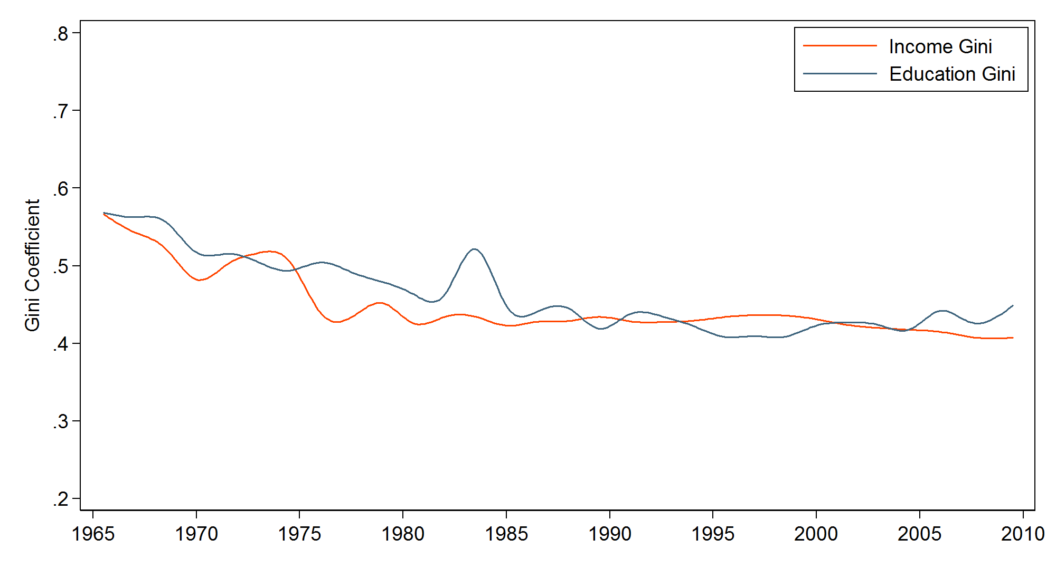
Trends in Income and Education Inequality

Slide 6
Contribution to the Literature
Our study improves upon the existing literature and contributes in the following ways:
We examine distributional changes in education attainment among subpopulations within countries at the micro-level
We quantify the opportunity cost of existing inequalities
We determine within country changes in economic inequality as a result of reducing educational gaps

Slide 7
Empirical Strategy
The objective of this research is to construct a counterfactual labor market response to a hypothetical elimination of education disparities between groups
We employ a Oaxaca-Blinder decomposition technique
Enables us to explain employment and wage gaps between groups due to observed and unobserved factors
Technique is prevalent in the Economics and discrimination literature (Oaxaca, 1974; Blinder, 1974)
Our focus will be on labor market differences due to gaps in education attainment

Slide 8
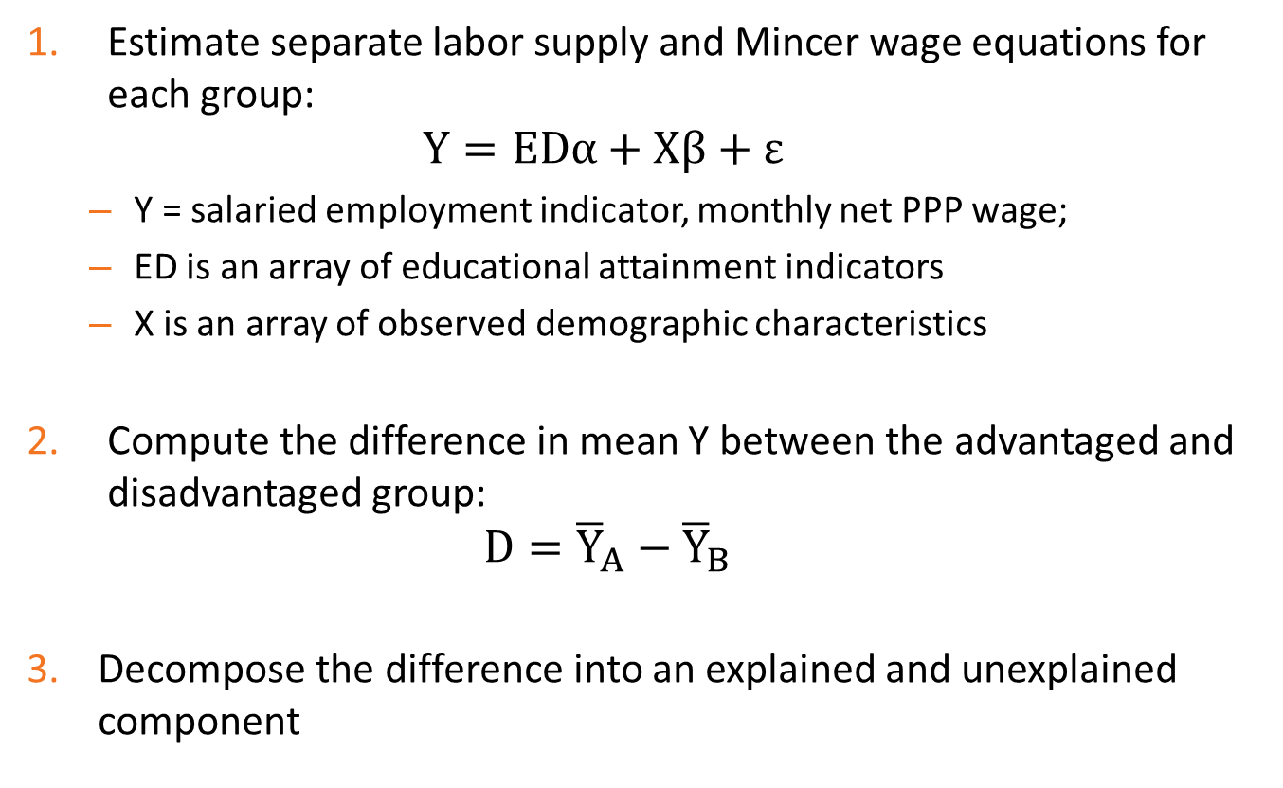
Procedure
Estimate separate labor supply and Mincer wage equations for each group:
$$Y=EDα+Xβ+ε$$
Y = salaried employment indicator, monthly net PPP wage;
ED is an array of educational attainment indicators
X is an array of observed demographic characteristics
Compute the difference in mean Y between the advantaged and disadvantaged group:
$$D={\overline{Y}}_{A}−{\overline{Y}}_{B}$$
Decompose the difference into an explained and unexplained component

Slide 9
Procedure
The decomposition is constructed as follows:
$$D=\left({\overline{ED}}_{A}−{\overline{ED}}_{B}\right)α_{B}+\left({\overline{X}}_{A}−{\overline{X}}_{B}\right)β_{B}+{\overline{ED}}_{A}\left(α_{A}−α_{B}\right)+{\overline{X}}_{A}\left(β_{A}−β_{B}\right)$$
Which reduces to
$$D=Δ\overline{ED}α_{B}+Δ\overline{X}β_{B}+{\overline{ED}}_{A} Δα+{\overline{X}}_{A} Δβ$$
As a result, $Δ\overline{ED}α_{B}$ is the parameter of most interest to our study
Explained Difference
Unexplained
Difference
Due to Education Gap

Slide 10
Data
Micro-level data are drawn from the following sources:
World Bank Living Standards Measurement Survey (LSMS)
World Bank STEP Skills Measurement Survey
IPUMS International
The analytic data cover 25 countries
Most recent year between 2005 and 2013
Restrict the analysis to the population aged 25-59 years
Minimize effect of education attendance and retirement decisions

Slide 11
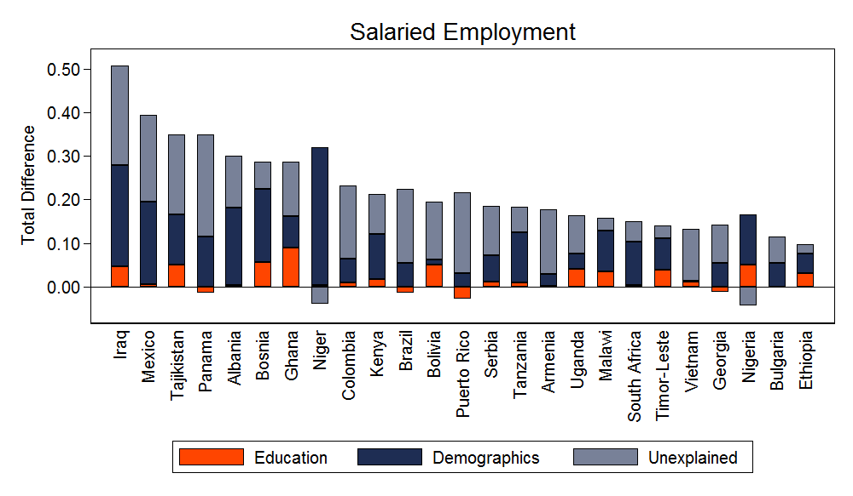
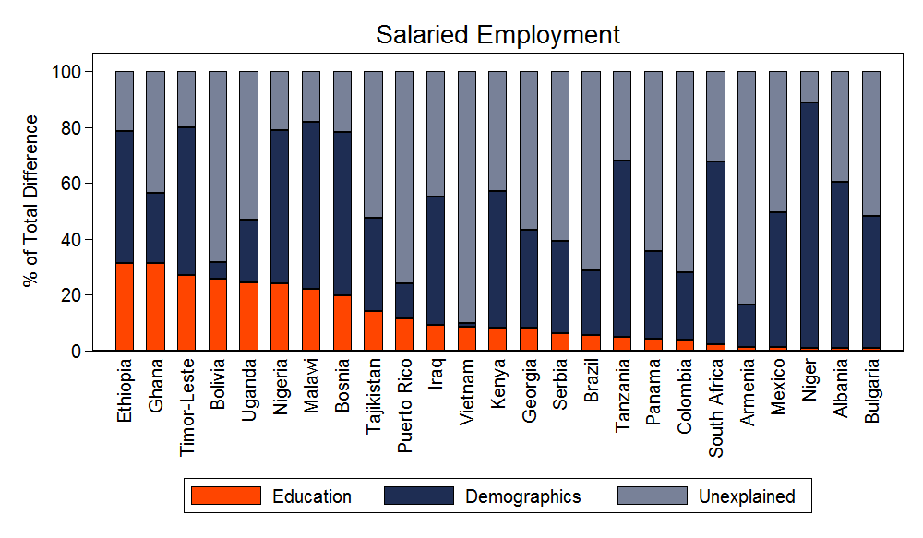
Results – Gender Employment Inequality
We observe between a 10% and 50% total gap in salaried employment
Much of the gender employment gap is due to differences in their demographics (household head, marital status, children) and due to unobserved differences (discrimination)
Still, reducing the education gap completely is associated with a 13% gain in total employment among females

Slide 12
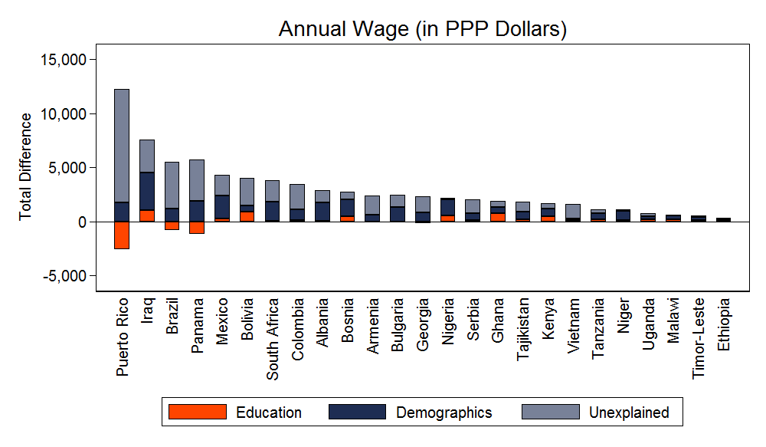
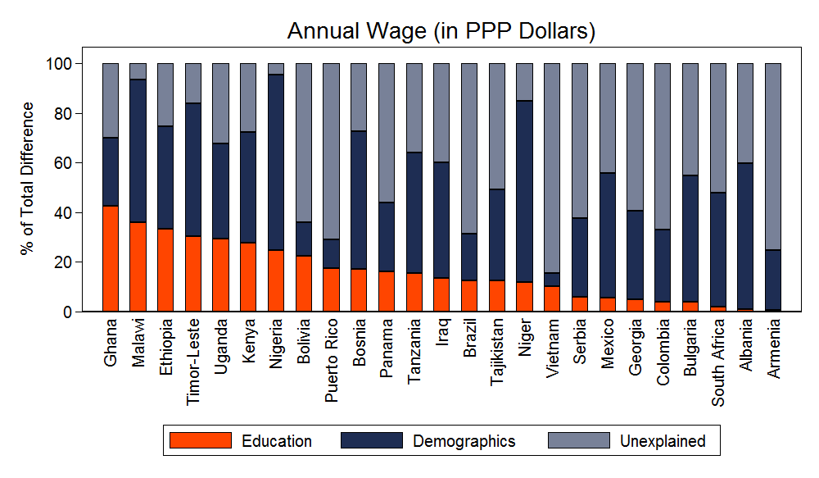
Results – Gender Pay Inequality
Gender pay gaps vary substantially between countries, even with PPP adjustment
Education still explains a relatively modest amount of the gender pay gap
Around 40% in Ghana and Malawi
Less than 20% in 15 countries
Further, reducing the education gap completely results in a 29.6 percent gain in wages

Slide 13
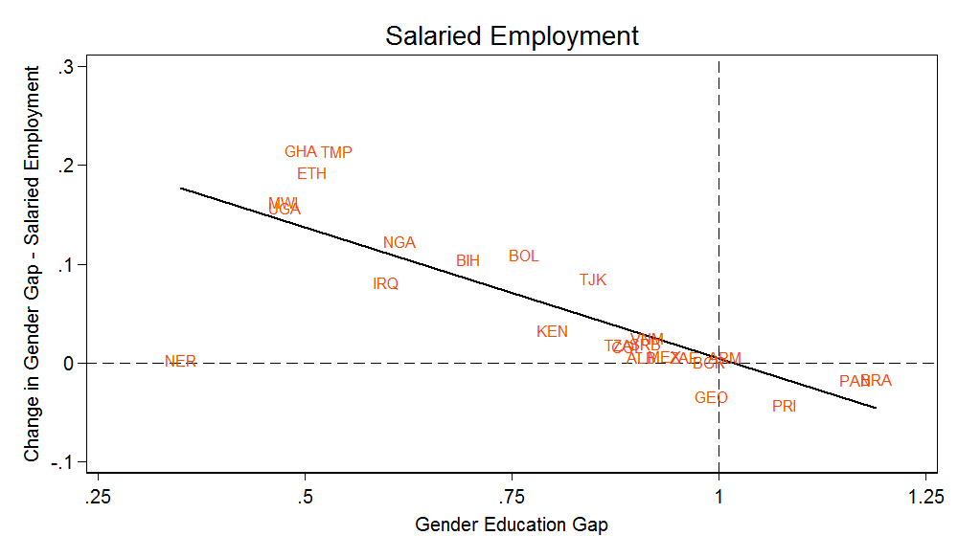
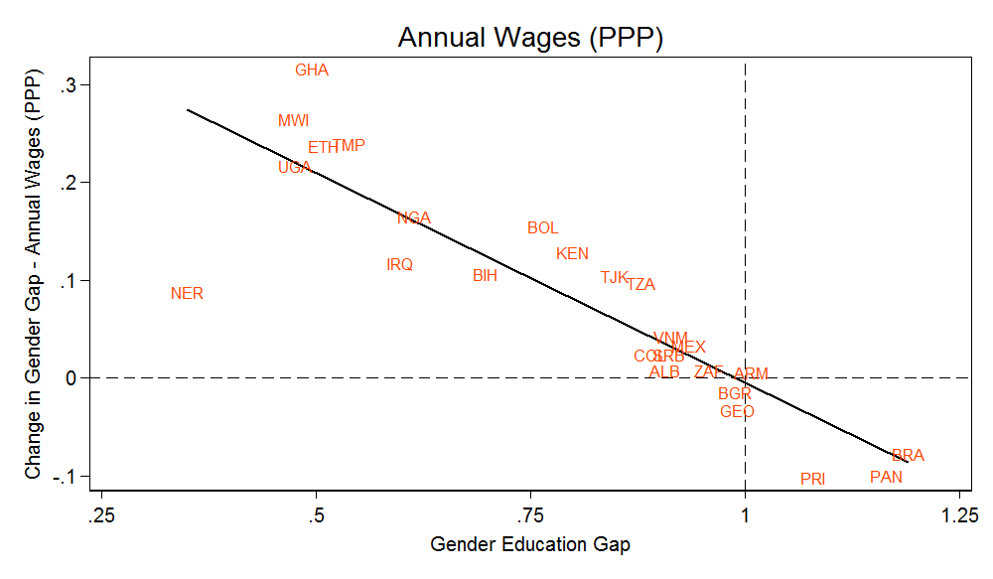
Results – Gender Pay Inequality
We also examine the impact of reducing the gender education gap on the gender employment and pay gaps
We find clear indications that larger reductions in gender education gaps are associated with larger reductions in the employment and pay gap
For instance, a 50 percent reduction in the gender education gap in Ghana results in about a 30 percent reduction in the gender pay gap

Slide 14
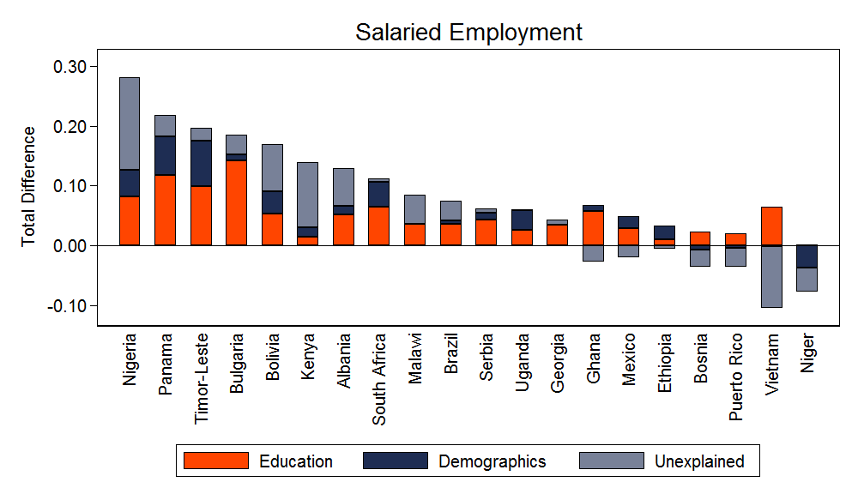
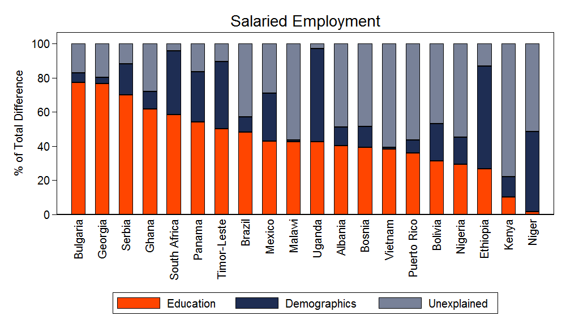
Results – Ethnic/Religious Employment Inequality
The employment gaps between ethnic/religious groups are not as stark as between genders
Education explains a more substantial portion of the employment inequality
On average, education explains 44% of the total employment gap
Reducing the education gap is more effective in Eastern Europe (up to 77%) than in Sub-Saharan Africa (as little as 2%)
If the education gaps were eliminated, we estimate that total salaried employment would increase by an average of 32%

Slide 15
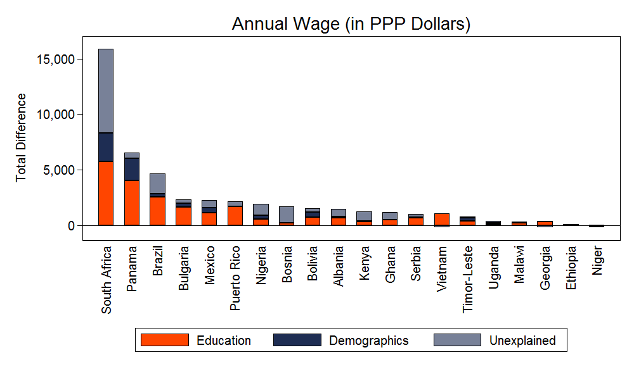
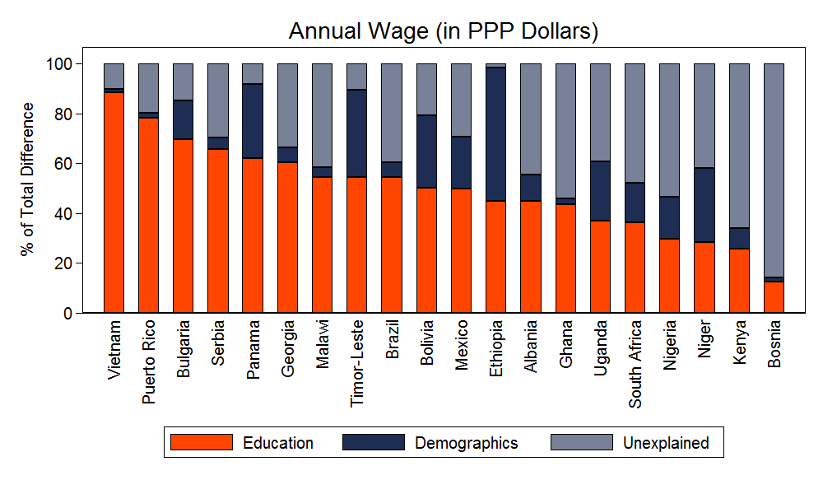
Results – Ethnic/Religious Employment Inequality
Different countries exhibit varying levels of pay gaps between ethnic/religious groups
e.g. South Africa pay gap between Whites and non-Whites is over $15,000 per year
Gaps in education are responsible for up to 88% of the wage disparity (Vietnam)
At minimum education explains 13% of the total wage gap (Bosnia)
Across all countries, education inequality plays the largest role in income inequality
A complete reduction in the educational inequality yields average gains of 93% in annual wages among disadvantaged ethnic/religious groups

Slide 16
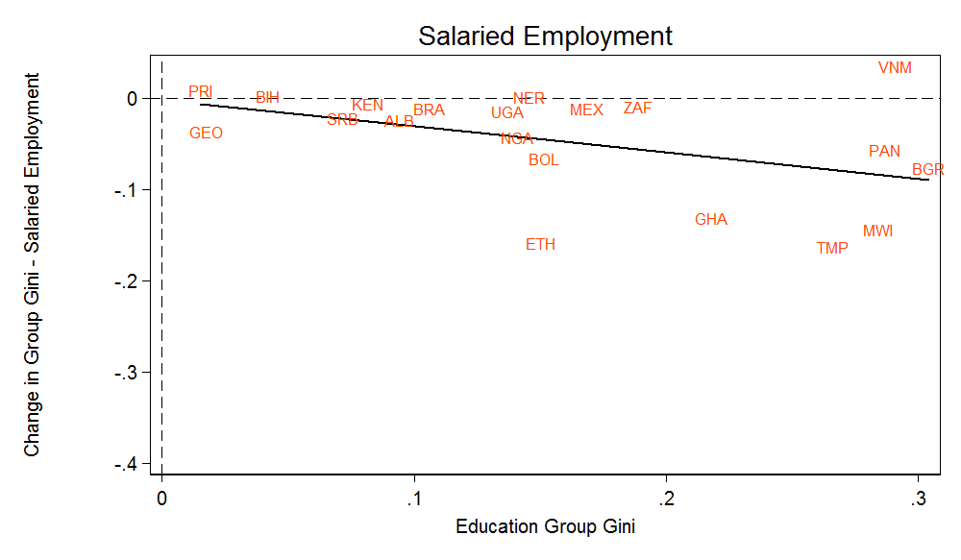
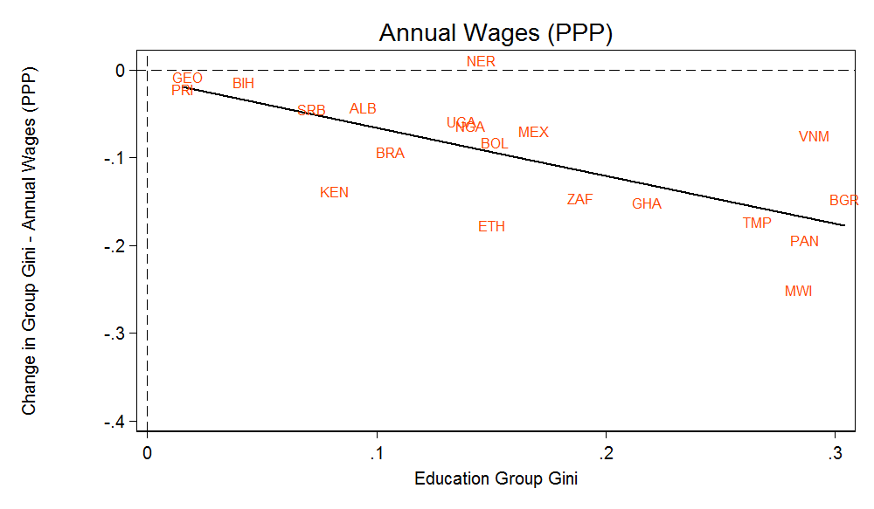
Results – Ethnic/Religious Employment Inequality
We examine changes in employment and income Gini coefficients in relation to changes in the group education Gini
We find that larger improvements in education inequality are associated with larger gains toward economic equality
For instance, lowering education Gini in Malawi by 30 points yields about a 25 point gain in income Gini
The gains in economic Gini are greater in terms of annual wages than salaried employment

Slide 17
Discussion
Results support the hypothesis that reducing education gaps has a positive impact on reducing economic inequality, via the labor market
Bridging the education gaps between groups can lead to substantial economic gains, especially to disadvantaged ethnic/religious groups and to a lesser extent females
For females, we find that certain observable and unobservable factors, which can be construed as discrimination, explain a substantial portion of the existing inequalities

Slide 18
Discussion
Eliminating education inequality between genders yields:
13% increase in salaried employment
7 point (mean of 54) decrease in the employment gap
30% increase in annual wages
11 point (mean of 39) decrease in the pay gap
Eliminating education inequality between genders yields:
32% increase in salaried employment
5 point (mean of 11) decrease in the employment Gini
93% increase in annual wages
11 point (mean of 18) decrease in the income Gini

Slide 19
Discussion
The existing gender gap in education is costing the Nigerian economy 538 Dollars (PPP) per working age female
Translates to approximately 17 billion Dollars (PPP) in foregone earnings
On the lower end, Armenia is losing only about 18 million PPP Dollars
The ethnic educational disparities in South Africa are associated with losses of about 5,768 Dollars (PPP) in annual wages per working age non-White individual
That is 115 billion Dollars (PPP) in annual earnings due to educational inequality

Slide 20
Conclusion
We provide evidence that ensuring an equitable distribution of education among a country’s disadvantaged groups can yield large economic gains
We determine the magnitude (and relative magnitude) of the economic costs of unequal education attainment by gender groups, ethnic/religious groups, and both
We identify a cross-country relationship between group education inequality and group economic inequality

